Slide 1
Data Race & DeadLock
Yubin Xia

Slide 2
Review: Bug Survey
Bug detection needs to look at order-violation bugs and multi-variable concurrency bugs
Testing can target at more realistic interleaving coverage goals
Fixing concurrency bugs is not trivial and not easy to get right
Support from automated tools is needed

Slide 3
Fancy Ways of Finding Bugs
Error handlers
C-P pattern miner
iComment
Invariable in the kernel

Slide 4
Checking function pointers
struct task_struct
struct file
files_struct *files
file_operations *f_op
struct files_struct
struct file_operations
Kernel text
file **fd
readdir:
push %ebp
…
int (*readdir)(file*,…)
task_struct *current_task
How does kernel get to function pointer?
Start at global root (symbol)
Traverse graph of data structures

Slide 5
Checking function pointers
evil_function:
push %ebp
…
struct task_struct
struct file
files_struct *files
file_operations *f_op
struct files_struct
struct file_operations
Kernel text
file **fd
✔
int (*readdir)(file*,…)
readdir:
push %ebp
…
task_struct *current_task
State-based control flow integrity [Petroni & Hicks]
Start at global root (symbol)
Traverse graph of data structures
Ensure function pointers point to valid entry points

Slide 6
Outline
Happens-before Race Detection
Lockset-Based Race Detection
Deadlocks
Detecting deadlocks using Lockset Analysis

Slide 7
Data Race Detection

Slide 8

What is Race?

Slide 9
Data Race
An undesirable situation that occurs when a device or system attempts to perform two or more operations at the same time, but the operations must be done in the proper sequence in order to be done correctly
multithread
distributed Programs
Key reason
separate processes or threads of execution depends on same shared state

Slide 10
Data Race
v = 0
[thread-1]
v += 1;
[thread-2]
v += 1;
v = ?

Slide 11
Data Race
v = 0 (memory)
T1 reads 0 to %reg
T1 increments %reg to 1
T1 stores %reg to v (v = 1)
T2 reads 1 to %reg
T2 increments %reg to 2
T2 stores %reg to v (v = 2)
v = 2; (memory)
v = 0
[thread-1]
%reg = v;
%reg++;
v = %reg;
[thread-2]
%reg = v;
%reg++;
v = %reg;
v = ?

Slide 12
Data Race
v = 0 (memory)
T1 reads 0 to %reg
T2 reads 0 to %reg
T1 increments %reg to 1
T2 increments %reg to 1
T1 stores %reg to v (v = 1)
T2 stores %reg to v (v = 1)
v = 1; (memory)
v = 0
[thread-1]
%reg = v;
%reg++;
v = %reg;
[thread-2]
%reg = v;
%reg++;
v = %reg;
v = ?

Slide 13
Data Race
The definition of data race:
1.two concurrent threads access a shared variable
2.at least one access is a write
3.the threads use no explicit mechanism to prevent the accesses from being simultaneous.

Slide 14
Remove Race Condition
Critical Sections
v = 0
[thread-1]
%reg = v;
%reg++;
v = %reg;
[thread-2]
%reg = v;
%reg++;
v = %reg;
v = ?

Slide 15
Remove Race Condition
Mutually-exclusive
lock & unlock
cli & sti
v = 0
[thread-1]
lock(mu)
%reg = v;
%reg++;
v = %reg;
unlock(mu)
[thread-2]
lock(mu)
%reg = v;
%reg++;
v = %reg;
unlock(mu)
v = 2

Slide 16
Data Race Bug
Thread-1
OpenInputStream()
{
PostEvent();
...
m_inputStream = ...
...
}
file: nsSocketTransport.cc
Thread-2
ProcessCurrentURL()
{
WaitEvent();
...
if (m_inputStream){
AsyncRead(m_inputStream);
}
...
}
file: nsImapProtocol.cpp
*Data race bug in Mozilla

Slide 17
Data Race Detectors
Two major categories:
Happens-before based
Lockset based

Slide 18
Happens-before Based

Slide 19

Happens-before Relation
The happens-before relation is a means of ordering events based on the causal relationship of pairs of events in a concurrent system
denoted:
Formulated by Leslie Lamport
strict partial order on events
without using physical clocks
*Times, Clocks, and Ordering of Events in a Distributed System

Slide 20
Rules in HB Relation
For the events A and B,
HB1: On the same sequential thread, A B if A executes before B.
HB2: On the different threads, A B if there is a synchronization that dictates A precedes B.
HB3: If A B and B C then A C
SAME Thread
DIFF Threads
R
R
execution order
W
synchronization dictates
W

Slide 21
HB based Detectors
The definition of data race:
1.a pair of accesses to the same memory location
2.at least one access is a write
3.neither one happens-before the other

Slide 22

Example
v = 0
[thread-1]
%reg = v;
%reg++;
v = %reg;
[thread-2]
%reg = v;
%reg++;
v = %reg;
without HB relation !!
v = ?

Slide 23
Example
v = 0
without HB relation !!
[thread-1]
%reg = v;
%reg++;
v = %reg;
[thread-2]
%reg = v;
%reg++;
v = %reg;
v = ?

Slide 24
Example
v = 0
[thread-1]
lock(mu)
%reg = v;
%reg++;
v = %reg;
unlock(mu)
[thread-2]
lock(mu)
%reg = v;
%reg++;
v = %reg;
unlock(mu)
HB relation !
v = 2

Slide 25
Pros and Cons
Pros:
Detect true data race
Cons:
Difficult to implement efficiently
Each thread, shared-memory location, and concurrent access
Depend on the interleaving produced by the scheduler
Miss data race

Slide 26
Lockset Based

Slide 27
Lock
The definition of lock:
1.a synchronization object used for mutual exclusion
2.a lock is either available or owned by a thread.
3.the operations on a lock m are lock(m) and unlock(m)

Slide 28
Lockset based Detectors
The definition of data race:
1.a pair of accesses to the same memory location
2.at least one access is a write
3.No lock protects all accesses to the same data

Slide 29
Lockset
Locking Discipline
A programming policy that ensures the absence of data races
e.g. “every variable shared between threads is protected by a mutual exclusion lock”
Principle
Check all shared memory accesses follow a consistent lock discipline
monitors all reads and writes, and infer the protection relation from the execution history

Slide 30
Algorithm of Lockset
The summary:
1.Let locks_held(t) be the set of locks held by thread t
2.For each v, initialize C(v) to the set of all locks
3.On each access to v by thread t, set C(v):= C(v) ∩ locks_held(t) if C(v)={ }, then issue a warning

Slide 31
Example
Programs locks_held(t) C(v) .
{ }
{mu1}
{mu1, mu2}
{mu1}
{}
{mu2}
{mu1, mu2}
{mu1, mu2}
{mu1}
{}
lock(mu1);
lock(mu2);
v = v + 1;
unlock(mu2);
v = v + 2;
unlock(mu1);
lock(mu2);
v = v + 1;
unlock(mu2);
Warning!!

Slide 32
Three Challenges
#1 Initialization
Shared variables are frequently initialized without holding a lock
#2 Read-only Shared Variable
write once and read all the time without lock
#3 Read-Write Lock

Slide 33
Solution to #1 and #2
Delay the refinement until the shared variable has been initialized
No easy way to know when initialization is done
Heuristic way: the first time to be accessed by the 2nd thread

Slide 34
Solution to #1 and #2
1.
Virgin
1.
the variable is NEW and has not yet been referenced by any thread.
read or write
by 1st thread
2.
3.
Exclusive
2.
the variable has been accessed by ONE thread only. Not update C(v)
C(v) is updated, but data races are NOT reported even if C(v) is empty.
read by new thread
write by new thread
4.
Shared
Shared- Modified
3.
write
4.
C(v) is updated, and data races are reported if C(v) is empty.
read or write
read

Slide 35
Solution to #3
Modify the algorithm:
1.Let locks_held(t) and write_locks_held(t) be the set of locks held in any mode and write mode by thread t
2.For each v, initialize Cr(v) and Cw(v) to the set of all locks
3.On each read to v by thread t, set Cr(v):= Cr(v) ∩ locks_held(t) if Cr(v)={ }, then issue a warning
4.On each write to v by thread t, set Cw(v):= Cw(v) ∩ write_locks_held(t) if Cw(v)={ }, then issue a warning

Slide 36
Pros and Cons
Pros:
More efficient way to detect data race
Predict data race that have not manifest
Cons:
Exists report false positive
Memory reuse
Limits the synchronization method to lock

Slide 37
Deadlock

Slide 38


What is a deadlock
This guy has no experience!!!
How can I get experiences without a job!!!

Slide 39
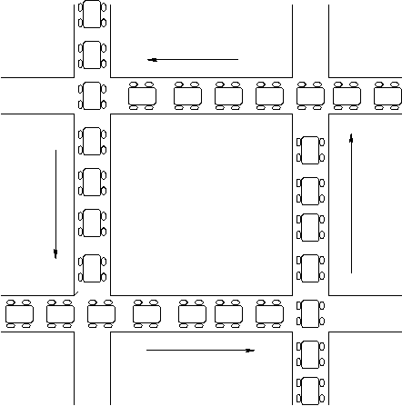
Deadlock Definition
A set of processes is deadlocked when
every process in the set is waiting for an event that can only be generated by some process in the set
Notes:
In the definition of deadlock we assume the set of processes contains at least two processes.
— A single process can deadlock itself, however, this is most likely a programmer error and there is little that the OS can do here.
Contrast deadlock with starvation (in the context of scheduling):
— When processes are deadlocked they are all in the waiting state.
— When a process is being starved it is continually in the ready state.
— Moreover, unlike deadlock, it is possible for a starved process to make the transition to the running state. It’s just that entities in the system are conspiring to ensure that this transition never occurs.
— When processes deadlock, it is a provable certainty that a state transition can never occur.

Slide 40
Deadlock
Circular waiting for resources
Thread A owns Res 1 and is waiting for Res 2 Thread B owns Res 2 and is waiting for Res 1
Thread
A
Wait
For
Owned
By
Res 1
Res 2
Owned
By
Wait
For
Thread
B

Slide 41
Four requirements for Deadlock
Mutual exclusion
Only one thread at a time can use a resource.
Hold and wait
Thread holding at least one resource is waiting to acquire additional resources held by other threads
No preemption
Resources are released only voluntarily by the thread holding the resource, after thread is finished with it
Circular wait
There exists a set {T1, …, Tn} of waiting threads
T1 is waiting for a resource that is held by T2
T2 is waiting for a resource that is held by T3
…
Tn is waiting for a resource that is held by T1

Slide 42
A Graph Theoretic Model of Deadlock
Basic components of any resource allocation problem
Processes and resources
Model the state of a computer system as a directed graph (called resource allocation graph, or RAG)
G = (V, E)
P_{i}
R_{j}
V = the set of vertices =
{P₁, ..., P_{n}} ∪ {R₁, ..., R_{m}}
E = the set of edges = {edges from a resource to a process} ∪ {edges from a process to a resource}
process
resource
(with 3 instances)
request
edge
allocation
edge
P_{i}
P_{k}
R_{j}
Notes:
For allocation edges, the edge is from a resource node (and not from an instance of the resource), to a process node.
— Resource instances are not nodes. They are an annotation.

Slide 43
Resource Allocation Graphs Example
A PostScript interpreter that is waiting for the frame buffer lock and a visualization process that is waiting for memory
V = {PS interpret, visualization} ∪ {memory frames, frame buffer lock}
Visualization
Process
Memory Frames
PostScript
Interpreter
Frame Buffer
Notes:
Are these serially reusable or consumable resources?
— Serially reusable! There are reused serially by processes.
How do you read this graph?
— 3 memory frames are allocated to the PostScript interpreter.
— The frame buffer is allocated to the visualization process.
— The visualization process is requesting memory.
— The PostScript interpreter is requesting the frame buffer.
This system is deadlocked.
— A set of processes are waiting for an event that can only be generated by another process in the set.
— But note that not all the processes are waiting for the same event. (There are several events (2 in this case) that can undeadlock the system.)

Slide 44
Resource Allocation Graphs & Deadlock
Theorem: If a resource allocation graph does not contain a cycle then no processes are deadlocked
A cycle in a RAG is a necessary condition for deadlock
Is the existence of a cycle a sufficient condition?
Game
Memory Frames
Visualization
Process
PostScript
Interpreter
Frame Buffer
Notes:
This Theorem says that a cycle in a resource allocation graph is a necessary condition for deadlock to occur.
In this example, these processes are not deadlocked.
— The memory request can be satisfied.
— Thus a cycle is not a sufficient condition for deadlock.

Slide 45
Single Resource RAG & Deadlocks
Theorem: If there is only a single unit of all resources then a set of processes are deadlocked iff there is a cycle in the resource allocation graph
Memory Frames
Visualization
Process
PostScript
Interpreter
Frame Buffer
Notes:
For the special case of single-unit resources, a cycle is a necessary and sufficient condition for deadlock.

Slide 46
An operational definition of deadlock
A set of processes are deadlocked iff the following conditions hold simultaneously
Mutual exclusion is required for resource usage
A process is in a “hold-and-wait” state
Preemption of resource usage is not allowed
Circular waiting exists (a cycle exists in the RAG)
Visualization
Process
Memory Frames
PostScript
Interpreter
Frame Buffer
Notes:
The precise conditions for deadlock can be expressed in terms of a graph (cliques and knots).
— For our purposes we’ll use a more operational definition of deadlock.
Note that circular waiting does not imply hold-and-wait (that is, we need both conditions).
— Circular waiting does not imply that any resources have actually been allocated (that any process actually holds a resource).

Slide 47
Dealing With Deadlock
Adopt some resource allocation protocol that ensures deadlock can never occur
Deadlock prevention/avoidance
Guarantee that deadlock will never occur
Generally breaks one of the following conditions:
Mutex, Hold-and-wait, No preemption, Circular wait
Deadlock detection and recovery
Admit the possibility of deadlock occurring and periodically check for it
On detecting deadlock, abort
Breaks the no-preemption condition
Notes:
Deadlock prevention: Guarantee (by the design of the system) that deadlock can never occur.
— Thus one need not worry how resources are allocated.
How easy/hard is this to do?
— Prevention is not likely to be possible in general.
— Mutual exclusion and non-preemptive use are properties that are inherent to the resource and the OS can’t change.
— At best the OS can only effect the hold-and-wait and circular waiting conditions.
Deadlock avoidance: Deadlock will be possible but we’ll continually check to ensure that it does not occur.

Slide 48
Deadlock Avoidance by Resource Ordering
Eliminate circular waiting by ordering all locks (or semaphores, or resources)
All code grabs locks in a predefined order
Problems?
Maintaining global order is difficult, especially in a large project
Global order can force a client to grab a lock earlier than it would like, tying up a resource for too long
Notes:
Where to start when aborting processes?
— Low priority processes.
— Processes with the most resources allocated.
Similar set of issues when trying to stop a system from thrashing…
A new approach is to checkpoint processes periodically and then “roll back” processes to the point of their last checkpoint rather than abort them completely.
— A roll-back is a form of partial abort.

Slide 49
Deadlock Detection & Recovery
Detection: periodic check RAG for cycles
How often should the OS check for deadlock?
After every resource request?
Only when we suspect deadlock has occurred?
Recovery: break the deadlock
Abort all deadlocked processes & reclaim their resources?
Abort one process at a time until all cycles in the RAG are eliminated?
Start from low priority process?
Start from processes with most allocation of resources?
Notes:
Where to start when aborting processes?
— Low priority processes.
— Processes with the most resources allocated.
Similar set of issues when trying to stop a system from thrashing…
A new approach is to checkpoint processes periodically and then “roll back” processes to the point of their last checkpoint rather than abort them completely.
— A roll-back is a form of partial abort.

Slide 50

LiveLock
Similar to a deadlock
The states of the processes constantly change with regard to one another
none progressing

Slide 51
Deadlock Pitfalls in Reality
Even deadlock-free code would deadlock once deployed
Due to dependencies on deadlock-prone third party libraries or runtimes
Examples: web browsers plug-ins, Java beans.
Upgrade of such libraries/runtimes can introduce new deadlocks during execution.

Slide 52
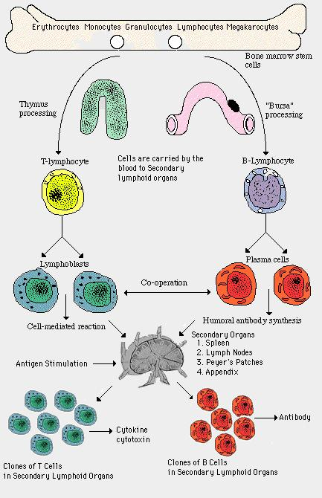


Slide 53
Dimmunix - Teaser
So, it is often hard to handle a deadlock. But what if…
Deadlock immunity:
once afflicted by a given deadlock, develop resistance against future concurrences of that and similar deadlocks
Dimmunix - a tool for developing deadlock immunity.
The first time a deadlock pattern manifests
Dimmunix automatically captures it’s signature and subsequently avoids entering the same pattern.

Slide 54
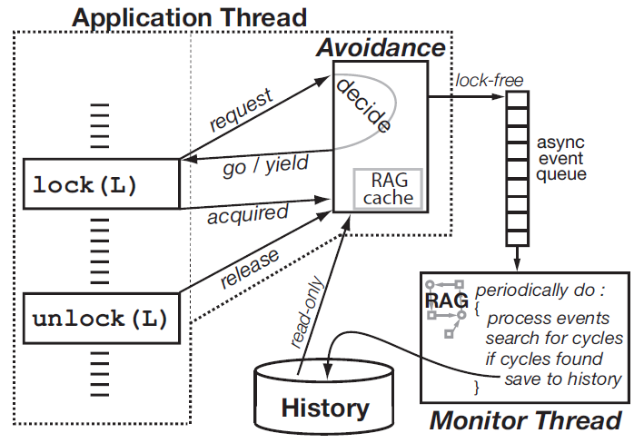
Dimmunix Architecture

